Slide 1

Ch.08 Designing your web database
Siva R Jasthi
ICS325 – Internet Application Development
Information and Computer Sciences
Metropolitan State University

Slide 2
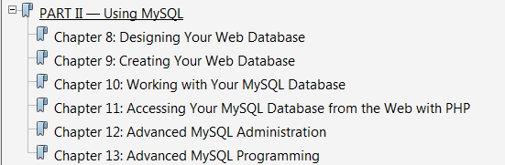
MySQL Module

Slide 3
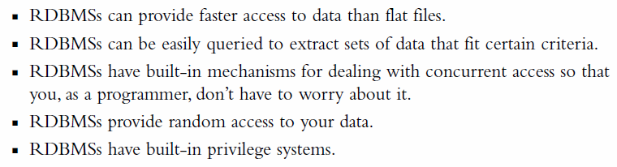




Power of RDBMS

Slide 4

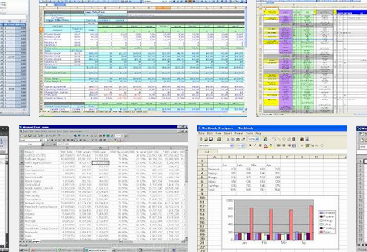
Relational Databases - Terms
Tables
Rows
Columns
Values
Data Types for Columns
Keys (Primary vs Foreign)
Relationships between Tables
Databases
Schema
Users, Roles, Access, Permissions

Slide 5
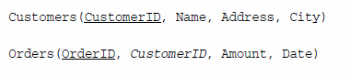
Database Schema
The complete set of table designs for a database is called schema.
It is a blueprint for the database.
A schema shows the tables, along with their columns, primary and foreign keys.
A schema does not contain any data.
Underlined terms are primary keys
Italic terms are foreign keys

Slide 6
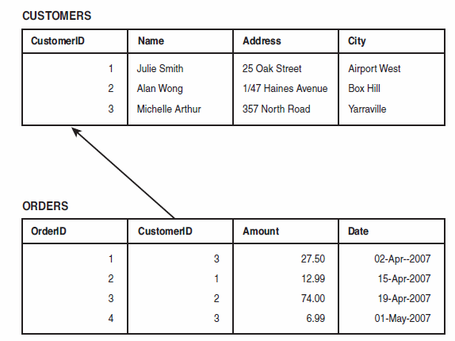

Database – Tables – Relationship through Keys

Slide 7
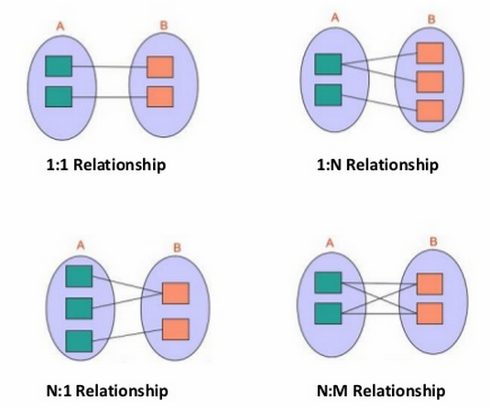
1:1, 1:N, M:N – Three types of relationships
Foreign keys represent a relationship between data in two tables.
Relationships are classified based on the number of elements on either side of a relationship
1:1 (one to one) Relationship (eg: Customer and Address)
1:N (one to many) Relationship (eg: Customer places many Orders)
M:N (many to many) Relationship (eg: Books and Authors; one book is written by several authors; And one author may have written several books)

Slide 8
Designing your web database
Think about the real-world objects
Avoid storing redundant data
Use Atomic column values
Choose sensible keys
Think about what you want to ask the database (queries)
Avoid designs with many empty attributes

Slide 9
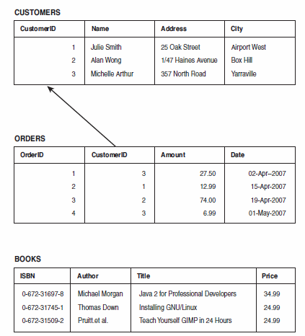
1. Think about the real-world objects
Programming Models are reflection of real life as you are solving a practical problem.
So, think about the real-world objects and their representation in the database.
If you are designing a book order system, here are some tables.

Slide 10
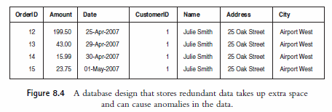
2. Avoid storing redundant data
Why have two separate tables “Orders and Customers”?
Why not store customer address along with order?
If customers places multiple orders, then their address is repeated for each order (as shown above). Such design poses two problems
[1] Wastage of Space: Why store the same data multiple times when you can store only once?
[2] Update Anomalies: Three kinds of update anomalies can occur.
Modification: If customer changes the address, it will have to be changed against all the orders. Otherwise, it would lead to inconsistent data.
Insertion: Each time the same customer places an order, the address need to be taken as input. It is possible that the data can be inconsistent (Saint Paul, St. Paul, Roseville)
(10th Ave NE, 10th Avenue North East, 10th Ave. NE)
Deletion: To preserve space, let us say you are all deleting the orders once those are shipped. Now, you have lost the information about your customer also.

Slide 11
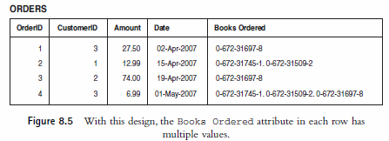
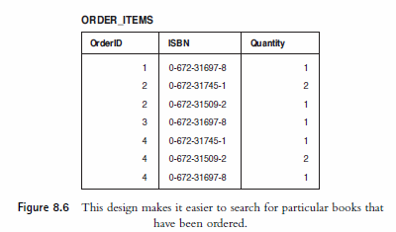
3. Use Atomic column values
Using Atomic values mean each column stores only one thing.
(Design 1) For example, books ordered can be placed inside a column with comma separated values. Basically, you are placing a table inside a table.
“How many books of XYZ are ordered?” Answering this question will be tricky in design 1 as you will have to read all the rows, parse those csv values, count those. (it is a big mess).
(Design 2) Place the quantity in another table. So, it is a simple SQL query to get the answer

Slide 12
4. Choose sensible keys
The “keys” are unique in each table.
MySQL provides ways to automatically create unique ID (like creating a serial number or row number in excel) using auto_increment parameter.
For example, Customers and OrderIDs have IDs generated through this fashion.
However, BOOKS do not need to have something created internally because ISBN is unique and hence can serve as “key”.
Similarly, for ORDER_ITEMS table, the combination of “OrderID + ISBN” (combination key) serves as unique key.
It is tempting to use auto-increment for every table.
Don’t !
Choose sensible keys

Slide 13
5. Think about what you want to ask the database (queries)
Why are we building this database?
What is the motivation? Vision? Requirement?
What kind of queries are we going to be pose to this database?
Is database schema sufficient enough to store the data we nee so that the queries can be answered?
Is database schema good enough to satisfy the performance? Can we optimize further for faster response times?
Make sure that the database contains all the data required.
Make sure that appropriate links exist between tables to answer the queries.

Slide 14
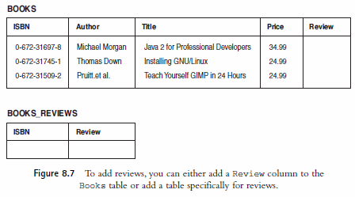
6. Avoid designs with many empty attributes
If you wanted to add book reviews (assume that there is only one review for each book) to the database, it can be done in two ways.
(Design 1) Adding “Review” column in the BOOKS table.
(Design 2) Creating “Books_Reviews” table.
In Design 1, if the reviewer is NOT reviewing all the books, then all those rows will have empty value in “Review” column. Having too many NULL values in a column is wastage of storage space. Such “null values” can cause problems.
When you total all the numerical columns, how should the NULLs be handled?
If there is NULL in a column, what does it mean? Is the attribute irrelevant? Is it empty? Data hasn’t been entered yet?
In Design 2, the separate table will avoid the problems of NULLs. This design also supports having multiple reviews for the same book (you need another REVIEW ID as unique key)

Slide 15
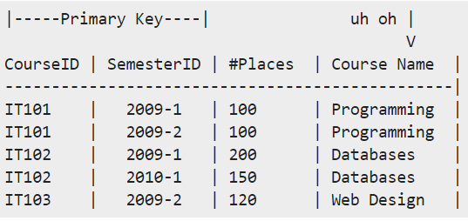
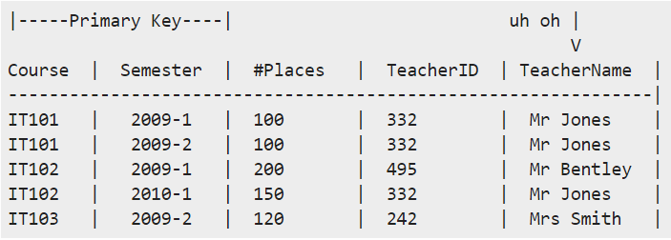
Database Normalization (1NF, 2NF and 3NF)
1NF: is the most basic of normal forms - each cell in a table must contain only one piece of information, and there can be no duplicate rows.
2NF: Any data in a row should depend on the entire / whole key.
3NF: Any data in a row should depend on just the key, not on other columns.
The data depends on the key [1NF],
the whole key [2NF] and
nothing but the key [3NF]
If 1NF is not satisfied, then 2NF and 3NF are NOT satisfied.
If 2NF is not satisfied, then 3NF is not satisfied
Not
2NF
Not
3NF

Slide 16
Summary of Table Types
Simple Tables:
Simple Tables that describe a real-world object.
These might contain keys to other simple objects (one to one or one to many relationships)
Linking Tables (Associative Tables):
Linking tables that describe many-to-many relationship between two real objects.
These linking tables are often associated with some kind of real-world transactions.

Slide 17
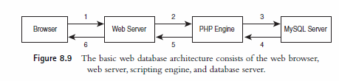
Web Database Architecture
Web Browser issues an HTTP request for a page.
Web Server receives this request, retrieves that page and passes to PHP Engine for processing.
PHP engine parses the script. This script contains the SQL commands / query string to fetch data from MySQL server.
MySQL server receives the database query, processes it, and sends the results – back to PHP Engine.
PHP engine finishes running the script, formats the query results nicely in HTML. It then returns the HTML to the web server.
Web server passes the HTML back to the browser.

Slide 18
Summary
Databases and excel spreadsheets – contains similar terminology (tables, rows, collection of tables)
However, avoid “spreadsheet syndrome” while designing the databases.
Remember the 6 principles
Rely on database design principles / Normalization Forms (1NF, 1NF, 3NF)
Think about the real-world objects
Avoid storing redundant data
Use Atomic column values
Choose sensible keys
Think about what you want to ask the database (queries)
Avoid designs with many empty attributes

